Slide 1
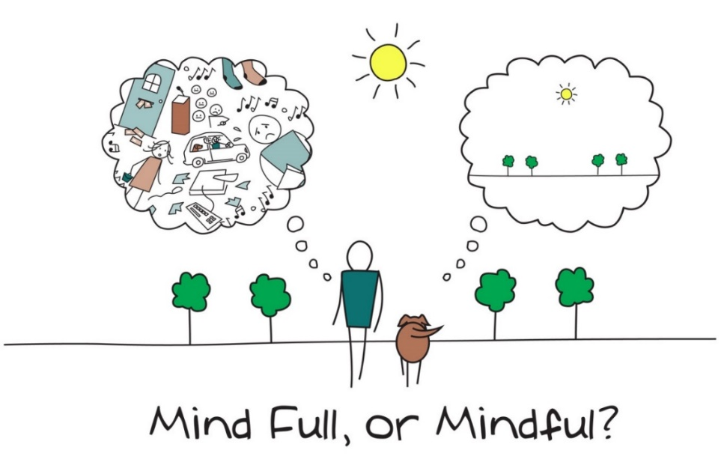
Is your mind full or are you mindful?
When?
The present/now
MINDFULNESS
Being awake to life experience
Present awareness
Kind awareness
This Photo by Unknown Author is licensed under CC BY-NC

Slide 2
What is Mindfulness?
In a business context…
‘When we are mindful, we can make conscious choices as to what we need to do in the particular situation in order to communicate effectively.’
Gudykunst, 2004:253 (Bridging Differences: Effective Intergroup Communication)
‘Mindfulness means being aware of our own and others’ behaviour in the situation, and paying focused attention to the process of communication taking place between us and dissimilar others…according to one’s internal assumptions, cognitions, and emotions.’
Ting Toomey, 1999:16, 267 (Consulting Across Cultures)
The Mindful International Manager, Jeremy Comfort & Peter Franklin
This Photo by Unknown Author is licensed under CC BY-SA-NC

